Slide 1

Research statement
Machine Learning and Optimization under Uncertainty of Engineering Systems
Nestor V. Queipo
nqueipo@berkeley.edu https://github.com/nqueipo/The-RICE-visit
Houston, June 17th 2019
Notes:
Adopt the same format used for the lecture; in motivation highlight the motivation de manera homologada

Slide 2
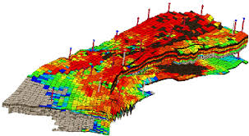
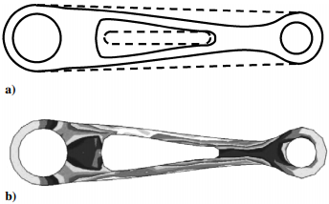
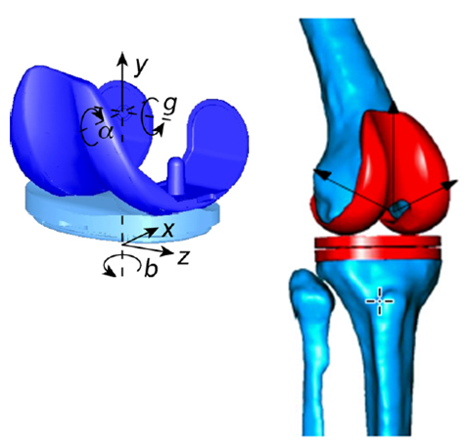
Vision
Integrate physical first principles and data-driven approaches for the more efective analysis and optimization under uncertainty of engineering systems, with applications to:
Oil production optimization (mature and heavy oil reservoirs)
Design and manufacturing
Biomechanics

Slide 3

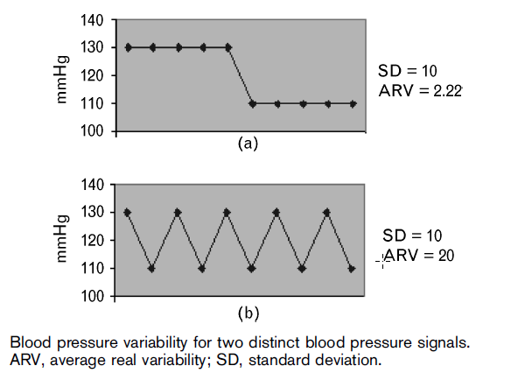
Heart disease
Key figure
Objective: assess whether blood pressure variability is an independent predictor of cardiovascular events and complications
Motivation: According to the World Health Organization (WHO), heart diseases are the Nº 1 cause of death globally… and in the US – American Heart Association Statistics Committee (2016). It costs the nation about $207 billion each year in health care services, medications, and lost productivity
Methodology: blood pressure variability modeling: average real variability (ARV) versus SD, survival analysis (time to event predictions), Maracaibo (Venezuela) population age study
Notes:
Add the expression for ARV

Slide 4
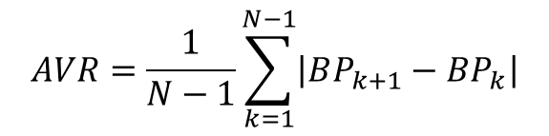
Heart disease
$$AVR=\frac{1}{N−1}\sum_{k=1}^{N−1}{\left|BP_{k+1}−BP_{k}\right|}$$
Measurable outcomes: the proposed blood pressure variability index (ARV) has entered clinical use at several national and international institutions, including Emory University’s Department of Epidemiology, Wayne State University’s School of Medicine, USA, the S. Luca Hospital, Istituto Auxologico Italiano, University of Milano-Bicocca, Italy, Université Paris Descartes, and Sorbonne Paris-Cité France.
Main reference L Mena, S Pintos, NV Queipo, J Aizpúrua, G Maestre, T Sulbarán (2005). A reliable index for the prognostic significance of blood pressure variability. Journal of Hypertension 23 (3): 505-511. doi: 10.1097/01.hjh.0000160205.81652.5a Google scholar: 289 citations

Slide 5
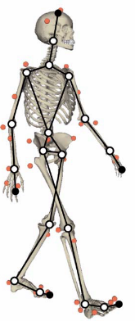
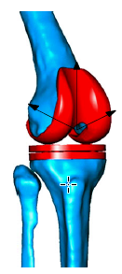
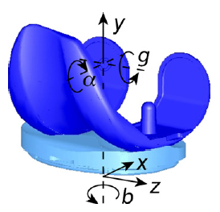
Biomechanics
Objective: speed up dynamic musculoskeletal simulations containing deformable joint contact models with applications to surgical planning, rehabilitation and orthopedic implant design
Motivation: “…according to the Arthritis Foundation, 66 million Americans currently suffer from chronic joint problems, costing the United heart disease States over $86 billion annually in medical costs and lost productivity—second only to heart disease as the leading cause of work disability”
Methodology: Dynamic musculoskeletal models (DMM) with deformable anatomic joints, machine learning with irregular feature space, multibody dynamic model of a Stanmore knee simulator machine

Slide 6
Biomechanics
Measurable outcomes: order of magnitude reductions in the computational cost of DMM while reasonably preserving accuracy in a Total Knee Replacement (TKR) model
Main reference YC Lin, RT Haftka, NV Queipo, BJ Fregly (2010) Surrogate articular contact models for computationally efficient multibody dynamic simulations. Medical engineering & physics 32 (6): 584-594. doi: 10.1016/j.medengphy.2010.02.008 Google scholar: 38 citations
Funding: Surrogate-Based Modeling of Joint Contact Mechanics, NSF Award 0602996, 05/2006-04/2009 (with Prof. Benjamin J. Fregly) $285,318

Slide 7
Probabilistic optimal design
Objective: the development of probabilistic design approaches that account for life-cycle uncertainty reduction measures (from design to post-design) in the the design and construction of lightweight and reliable products
Motivation: “… since the early 2000´s the US exhibit a negative trend regarding the US trade balance for advanced technological manufacturing products, with the deficit currently being well above $100 billion and the adoption of probabilistic design methods are associated with the manufacturing of more cost-effective and reliable products”
Methodology: Structural analysis, computational fluid dynamics and heat transfer, machine learning, global sensitivity analysis, uncertainty quantification, reliability-based and robust design optimization

Slide 8
Probabilistic optimal design
Measurable outcomes: showcased the value of adopting probabilistic optimal design approaches in the automotive (structural elements) and aerospace (rocket injector design) domains
Main references
NV Queipo, RT Haftka, W Shyy, T Goel, R Vaidyanathan, PK Tucker (2005) Surrogate-based analysis and optimization. Progress in aerospace sciences 41 (1): 1-28 (in collaboration with NASA). doi:10.1016/j.paerosci.2005.02.001 Google scholar: 1741 citations
NH Kim, H Wang, NV Queipo (2006) Efficient shape optimization under uncertainty using polynomial chaos expansions and local sensitivities. AIAA journal 44 (5): 1112-1116. doi:10.2514/1.13011 Google scholar: 58 citations
J Romero, NV Queipo (2018) An ANOVA approach for accounting for life-cycle uncertainty reduction measures in RBDO: the FSAE brake pedal case study. Structural and Multidisciplinary Optimization, 57(6): 2109–2125. doi:10.1007/s00158-018-1983-6
Notes:
Incorporate Google scholar citations for the SBO paper

Slide 9
Probabilistic optimal design
Funding: Short Cycle Surrogate-based Optimization, NSF Award 423280, 09/2004-09/2007 (with Prof. Raphael T Haftka) $213,202
Estimating Probability of Improvement in Next Cycle of Surrogate Based Design Optimization, NSF Award 0856431, 08/2009-08/2012 (with Prof. Raphael T Haftka) $256,000
Uncertainty Reduction by Testing, Inspection, Health Monitoring, and Maintenance (THIM) in Probabilistic Product on Design, NSF Award 0927790, 08/2009-08/2012 (with Prof. Nam-Ho Kim) $319,326

Slide 10
Oil production optimization under uncertainty
Objective: the development of an oil production optimization approach that accounts for complex reservoir dynamics, geological uncertainty, measurement noise and operational constraints
Motivation: The US dependence on oil and the fact that discoveries of conventional resources have declined throughout the years, make innovations in oil recovery methods from unconventional origins (e.g., heavy/extra heavy oil, mature fields, shale oil) mandatory to ensure that the industry has cost-effective methods for oil production
Methodology: reservoir simulation, time-dependent models, model prediction control, real-time learning, decision making under uncertainty

Slide 11
Oil production optimization under uncertainty
Measurable outcomes: Pioneered the adoption of machine learning models with uncertainty estimates for the global sensitivity analysis and optimization of complex oil recovery processes
Main references
NV Queipo, E Nava (2019) A gradient boosting approach with diversity promoting measures for the ensemble of surrogates in engineering, (accepted)
An adaptive MPC approach for the optimization under uncertainty of the operation schedule of SAGD recovery processes under uncertainty (in preparation). An earlier version was presented at the 2015 SPE LAPEC conference held in Quito, Ecuador
E Sanchez, S Pintos, NV Queipo (2008) Toward and optimal ensemble of kernel-based approximations with engineering applications, Structural and Multidisciplinary Optimization Journal, 36 (3): 247-261. doi:10.1007/s00158-007-0159-6 Google scholar: 88 citations

